Slide 1

PPE Course 2016
Case Study Uniformity

Slide 2
Overall workshop schedule
15:50 – 16:15 | Case study A in plenum
16:15 - 17:30 (with break) | Division into 4 groups Receive/open additional documents (Parts B to E) Every group works on a specific part (B – E): Group 1: Part B Group 2: Part C Group 3: Part D Group 4: Part E
17:30 – 18:15 | In the plenum: each group presents the situation and their findings (~ 10’)

Slide 3
Case study A

Slide 4
Raw mix components
Material | Source | Comments | Average use in raw mix | Moisture (%)
CR Limestone | Own Transported by barges |  | 81.3 | 10.8
Vulcan Limestone | Third party Transported by barges | Sweetener Used in small quantities | 3.6 | 8.9
Fly ash | Various sources |  | 9.6
Sand | Natural, wet |  | 2.7 | 8.4
Iron correctives |  |  | 0.5
Various alternative raw materials |  |  | 2.3

Slide 5
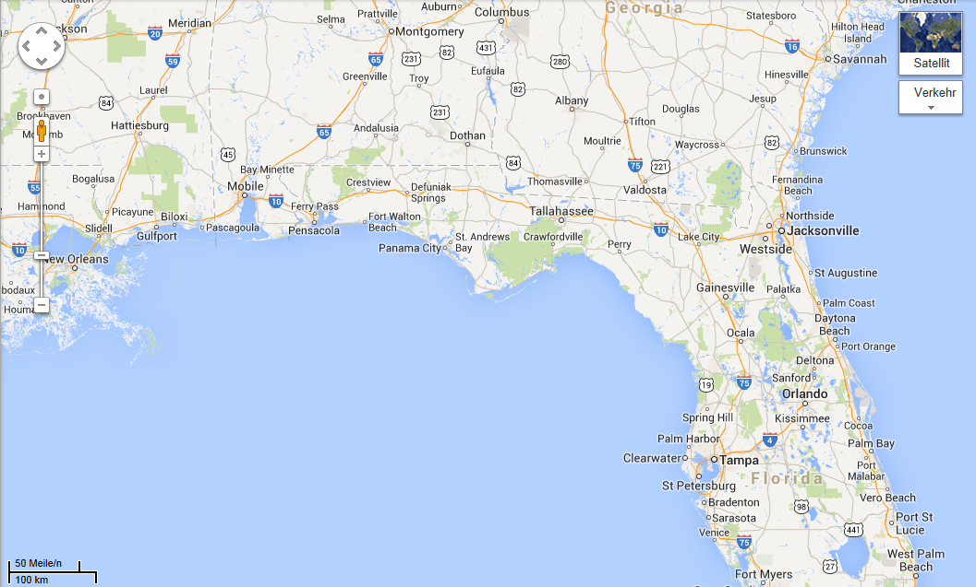
v
Plant
Quarry

Slide 6
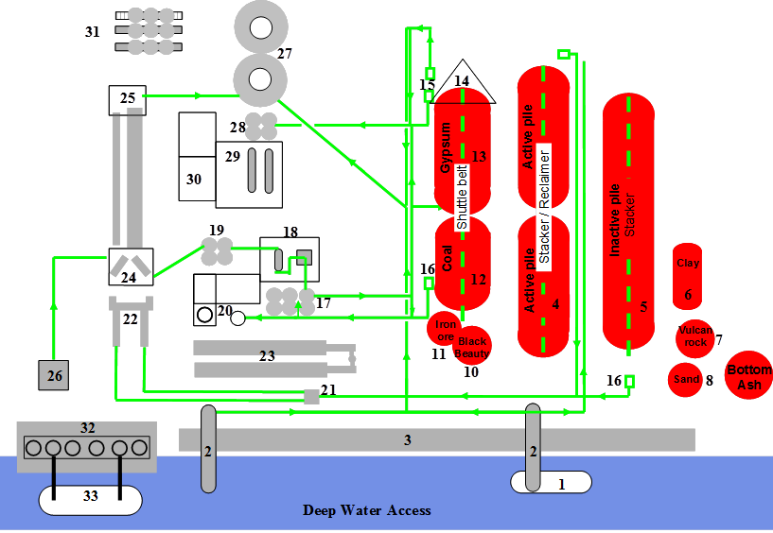
Plant layout
Cement
silos
covered
Limestone
Clinker
silos
Cement
mills
Homo
silos
Raw grinding
Dryers
Raw material unloading deck
Cement
barge
Raw material barge

Slide 7
Task A
Comment the extent of material variability and any additional observations with regard to raw meal, kiln feed and clinker analyses
Give feedback about:
Plant areas that need to be investigated further
Specific information you would need for the detailed investigation

Slide 8
Material uniformity
What are your observations regarding the material uniformity?

Slide 9
Material uniformity
Targets of excellence for raw meal, kiln feed and clinker with regard to short and long term uniformity
Material | Moduli | Short term uniformity | Long term uniformity
 |  | Daily Hourly samples Average of daily std | Monthly Daily averages Std of daily average
Raw meal | LS σ | < 3.6* | < 1.0
Kiln feed/clinker | LS σ | < 1.2 | < 1.0
 | SR σ | < 0.04 | < 0.03
 | AR σ | < 0.04 | < 0.03
*Guide value for plants with pre-blending systems

Slide 10
Variation CaOf versus lime saturation in clinker
What do you observe?

Slide 11
Areas to study in detail
Raw meal
Chemical composition/variation of the raw mix components
Raw mix weight feeder situation
Kiln feed
Blending efficiency
Clinker
Quality control (samplers, sampling points, frequency, analytics)
Quality control concept
Dust handling system
Fuel variation

Slide 12
Groups

Slide 13
Overall work schedule
16:15 - 17:30 (with break) | Division into 4 groups Receive/open additional documents (Parts B to E) Every group works on a specific part (B – E): Group 1: Part B (Raw material preparation) Group 2: Part C (Raw grinding) Group 3: Part D (Clinker production) Group 4: Part E (Quality control)
17:30 – 18:15 | In the plenum: each group presents the situation and their findings (~ 10’)

Slide 14
Group work on case study
Group I | Group Members
Coach: Lisa Moser
Topic: Raw Material Preparation

Slide 15
Group work on case study
Group II | Group Members
Coach: Alejandro Gutiérrez
Topic: Raw Grinding

Slide 16
Group work on case study
Group III | Group Members
Coach: Vincent Olivier
Topic: Clinker Production

Slide 17
Group work on case study
Group IV | Group Members
Coach: Astrid Gruskovnjak
Topic: Quality Control

Slide 18
Case study B – Raw material preparation

Slide 19
Details regarding excavation and storage
Excavation of CR limestone
from pits with a drag chain; limestone is contaminated by pockets of sand
limestone is deposited for several weeks along the ponds to drain the water
material passes through a PGNAA before loading; inadequate quality can be stored on an intermediate stockpile
barges can load 29’000t of limestone
Storage at plant
2x45’000t longitudinal bed; chevron type stacking; side reclaiming
Sand
High grade and uniform

Slide 20
Details regarding drying of limestone and sand
Drying
CR limestone (average moisture 10%) and sand (average moisture 8%) are dried in rotary driers
Drying is done alternatingly leading to following silo set up:
Dried sand & dust of sand drying &
dust of transition periods
CR/Vulcan limestone mix
CR limestone
Limestone dust & kiln dust
Silo 1
Silo 2
Silo 3
Silo 4

Slide 21
Composition of raw materials at feed silo outlet
SiO2 range of limestone from silo 1 and 2 is too large
How to improve:
More stringent control at quarry
Upgrade the active stockpile
Silo 1
Silo 2
Silo 3
Silo 4
Silo 5/6
Silo 8

Slide 22
Received sand vs feed silo outlet sand
Sand at the feed silo outlet shows huge variation due to contamination with limestone and kiln dust
How to improve:
Feed wet sand directly to roller press

Slide 23
Case study C – raw grinding

Slide 24
Details regarding feed silo set-up
Components | Silo# | Capacity (t)
Dried sand (& dust) | 1 | 3300
Dried limestone mix (CR & Vulcan) | 2 | 4200
Dried CR limestone | 3 | 4200
Dust (limestone & kiln) | 4 | 1150
Fly ash | 5 | 1200
Fly ash | 6 | 1200
Not operational | 7 | -
Iron ore | 8 | 1100
How to improve:
Modify outlets of limestone and iron corrective silo
Silo 2 & 3: frequent flushing
Silo 8: bridging and rat-holing → funnel-flow sequence
Silo 7: wet sand handling failed due to reclaiming problems from silo and bag clogging of auxiliary dust collectors

Slide 25
Flow sheet of raw grinding system
Long resident &
respond time
Very short resident
& respond time

Slide 26
Case study D – clinker production

Slide 27
Quality relevant aspects of clinker production
The following aspects may potentially have an impact on kiln feed and clinker variability:
The kiln and the dryers have a common de-dusting system. The combined dust is stored in silo 4 and fed back to the raw grinding system
The coal mill is dried with part of the kiln exhaust gas. Ground coal thus includes some kiln dust
The fuel combination is subject to variations, particularly with regard to TDF use.
It is known that the top cyclone efficiency is not optimal.

Slide 28
Kiln feed and clinker lime saturation for one month
Kiln feed
Clinker
Delta
Difference in lime saturation between 10-25 points
Where does that difference come from?

Slide 29
Detailed kiln data for one month
t/h kiln feed
?
t/h for TDF
t/h coal
Coal ash incorporation (12% ash content)

Slide 30
Factors contributing to the difference in LS
Coal ash incorporation
Changing fuel mix and hence changing ash incorporation (TDF versus coal)
Changing ash content of the coal (influenced by kiln dust adsorption during coal grinding
Dust loss at top cyclones
Changing amount and composition of kiln dust leaving the top cyclones. This could be influenced by the kiln production rate.
Analytical inconsistencies
How to improve:
Stabilize fuel mix
Improve efficiency of top cyclones (optimize feed location of fresh kiln feed; modify top cyclone stage)

Slide 31
Case study E

Slide 32
Quality control in raw meal preparation

Slide 33
Quality control in raw meal preparation

Slide 34
Cross-check samples of raw meal and kiln feed
Cross-check analysis between plant and HTEC lab show significant differences

Slide 35
Calibration standards
Good agreement between TH and HTEC analysis on plant specific calibration standards

Slide 36
Reasons for analytical differences
Status:
Plant performs analysis on pressed pellets
Calibration standards are several year old
Why:
Change in mineralogical characteristics of the raw meal
Pressed pellets are sensitive to such changes (matrix effect)
How to improve:
Preparing new calibration samples reflecting actual raw mix composition
Implementing fused bead method as a reference method (not sensitive to mineralogical effects)

